Slide 1
ONLINE MOBILE SHOPING DATABASE
DBMS PROJECT
NATIONAL INSTITUTE OF TECHNOLOGY, WARANGAL
PARTICIPANTS DETAILS:-
ANSHU KUMAR (ROLL NO. 21CSB0A05)
UJJWAL KUMAR SINGH (ROLL NO. 21CSB0B61)

Slide 2
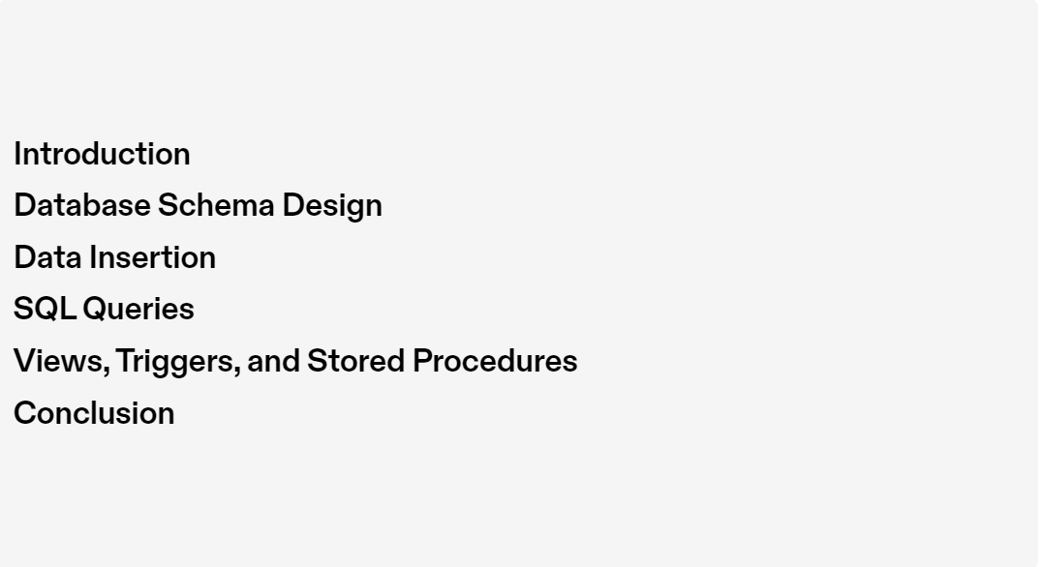
CONTENTS:-

Slide 3


Slide 4
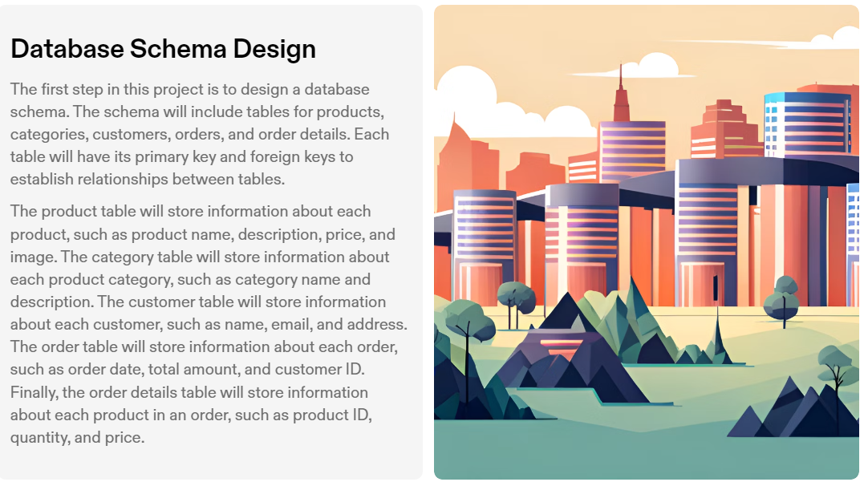

Slide 5
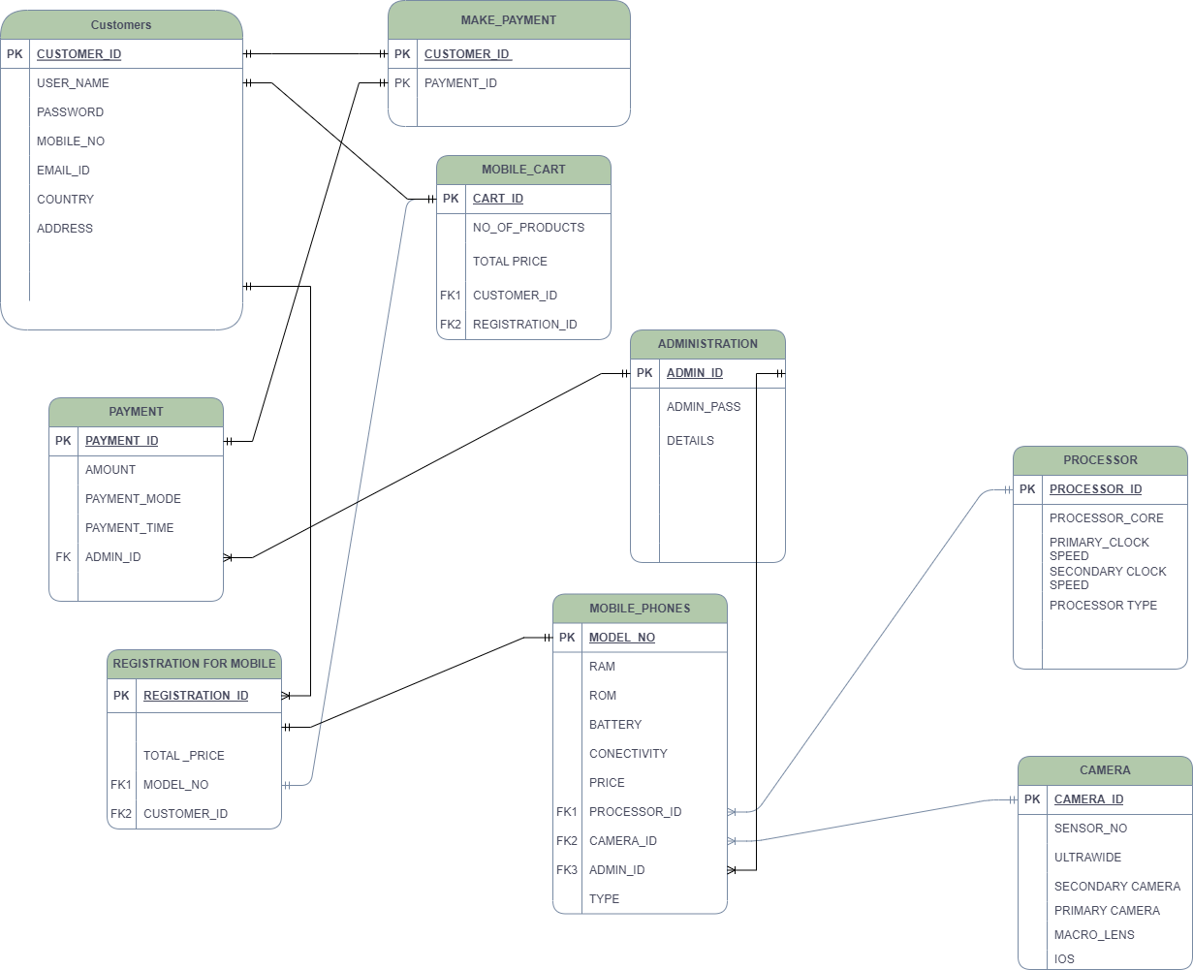
The Database schema consists of multiple tables that are related to each other in the following way:
1. The CUSTOMERS1 table stores customer information, including their unique C_ID, USER_NAME, PASS, MOBILE_NO, EMAIL, COUNTRY, and ADDRESS.
2. The PAYMENT table contains details about payments made by customers. It has a unique PAYMENT_ID, along with columns for AMOUNT, PAYMENT_MODE, PAYMENT_TIME, and ADMIN_ID, which references the ADMINISTRATION table.
3. The MAKE_PAYMENT table serves as a junction table, establishing a many-to-many relationship between customers and payments. It includes C_ID and PAYMENT_ID columns to link customers with their respective payments.

Slide 6
4. The CART table represents the shopping carts of customers. It has a unique CART_ID and includes columns for NO_OF_PRODUCTS, TOTAL_PRICE, CUSTOMER_ID (referencing CUSTOMERS1), and REGISTRATION_ID (referencing REGISTRATION1).
5. The ADMINISTRATION table stores information about administrators. It has an ADMIN_ID (primary key), PASSWORD, and DETAILS columns.
6. The CAMERA table contains details about different camera models. It includes a unique CAMERA_ID, along with columns for MACROLENS, MAINCAMERA, ULTRAWIDE, IOS, and SENSOR_NO.
7. The REGISTRATION1 table stores registration information for customers. It has a REGISTRATION_ID (primary key), MODEL_NO (referencing PHONE), TOTAL_PRICE, and CUSTOMER_ID (referencing CUSTOMERS1).
8. The PROCESSOR table holds information about different processors. It includes a unique PROCESSOR_ID (primary key), along with columns for PROCESSOR_TYPE, PRIMARY_CLOCK_SPEED, SEC_CLOCK_SPEED, NO_OF_CORE, and NO_OF_THREADS.
9. The PHONE table represents different phone models. It includes a unique MODEL_NO (primary key), along with columns for RAM, ROM, CONNECTIVITY, BATTERY, PRICE, PROCESSOR_ID (referencing PROCESSOR), CAMERA_ID (referencing CAMERA), and ADMIN_ID (referencing ADMINISTRATION).
The entire table relation reflects a database structure for managing customer data, payments, shopping carts, administrators, camera models, registrations, processors, and phone models, allowing for efficient organization, querying, and manipulation of the data while maintaining data integrity and relationships.

Slide 7
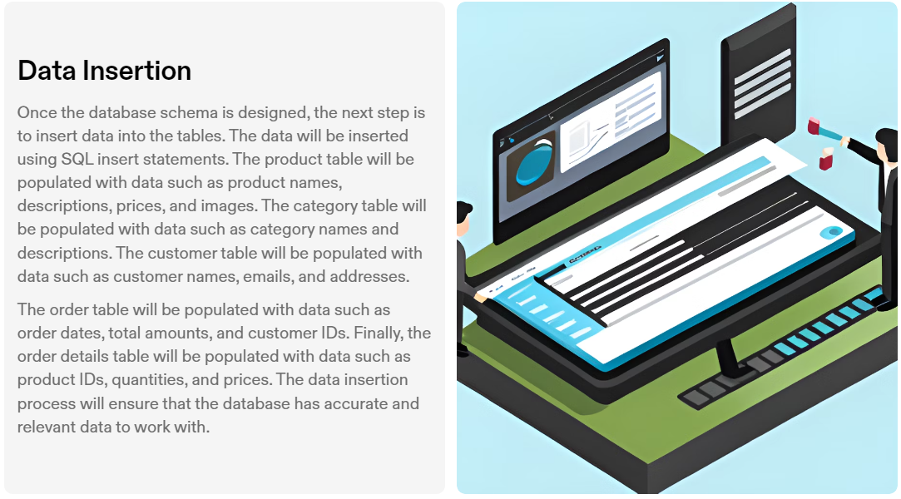

Slide 8
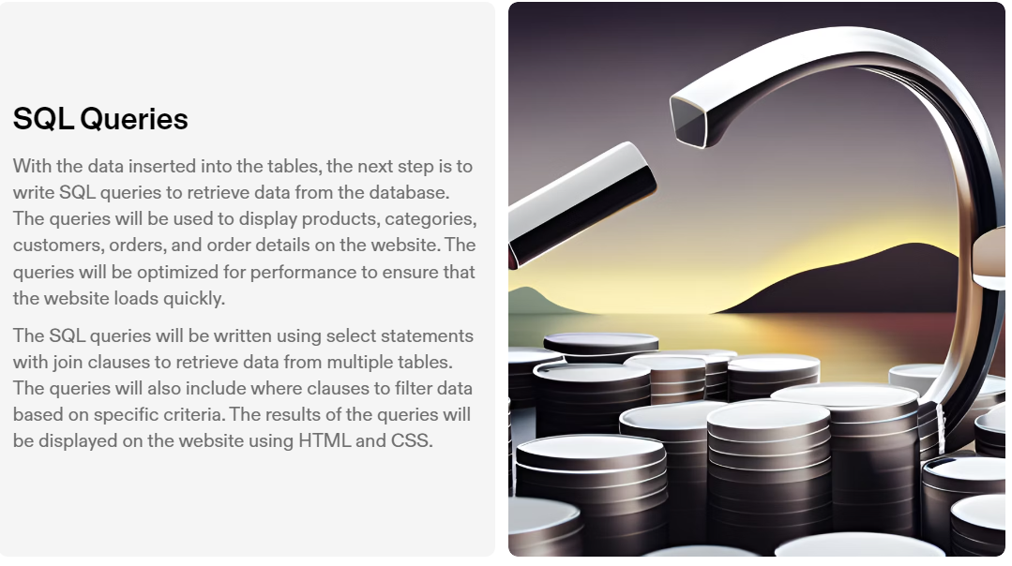

Slide 9
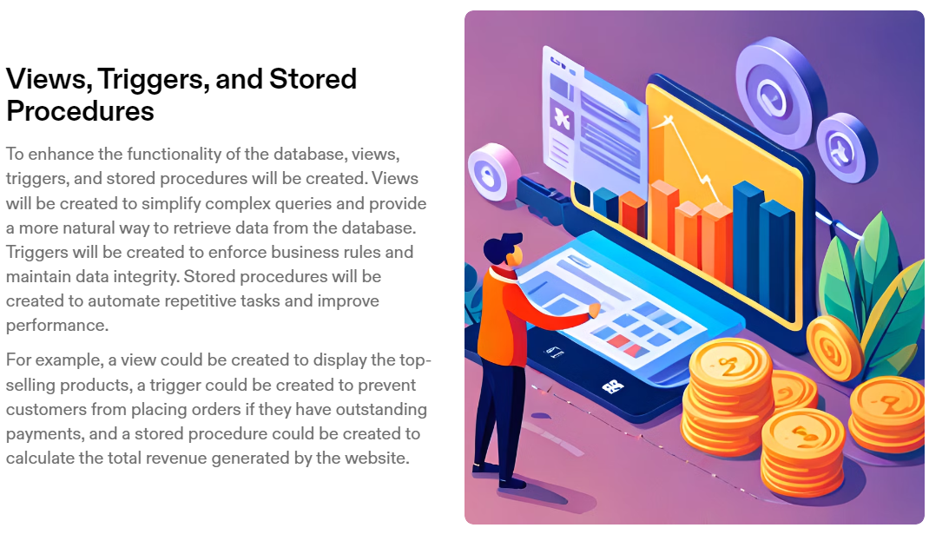

Slide 10

Conclusion
In conclusion, this SQL project for an online mobile shopping website involves designing a database schema, inserting data into the tables, writing SQL queries to retrieve data from the database, and creating views, triggers, and stored procedures to enhance the functionality of the database. The project will help to create a mobile-friendly website that provides an excellent user experience and helps businesses to increase their sales.
This project demonstrates the importance of having a well-designed database for an online shopping website and the critical role that SQL plays in creating and managing databases. By completing this project, students will gain valuable skills in database design, SQL programming, and web development.

